Slide 1
CS1010X Lecture 8:
Working with Sequences
Notes:
Lecture 8a video

Slide 2
Quick Review
Lecture 1: get to know Python
Lecture 2: solve with a single function / abstraction
Lecture 3: solving with many functions…
Lecture 4: solving with recursion/iteration
Lecture 5: Debugging
Lecture 6: Higher Order Function (Function(al) Abstraction)
Lecture 7: Data Abstraction (using tuple)
Lecture 8: Working with sequence
- beyond number, string….building more ADTs
tuple (this lecture again) , and recursion vs iteration
- Signal-processing view of computation….
- processing tree (tuple of tuples)

Slide 3
Sequence
(in general)

Slide 4
Sequence vs Collection
Sequence is the generic term for an ordered set:
Tuple: immutable sequence ( )
List: mutable sequence [ ]
String: immutable, special type to store characters ' '
Collection can be ordered or unordered group of items:
Tuple: ordered, allow duplicate members ( )
List: ordered, allow duplicate members [ ]
Dictionary: unordered, mutable, indexed, no duplicate { : }
Set: unordered, mutable, unindexed, no duplicate { }

Slide 5
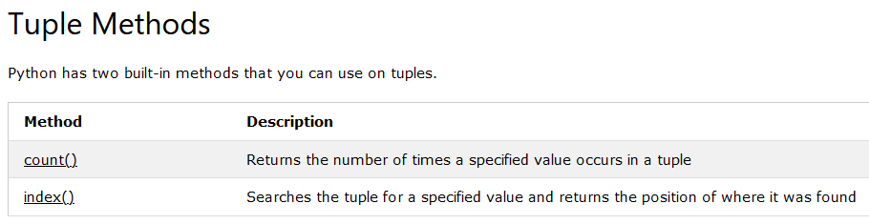
tuple works like string (Lecture 7)
https://www.w3schools.com/python/python_tuples.asp

Slide 6
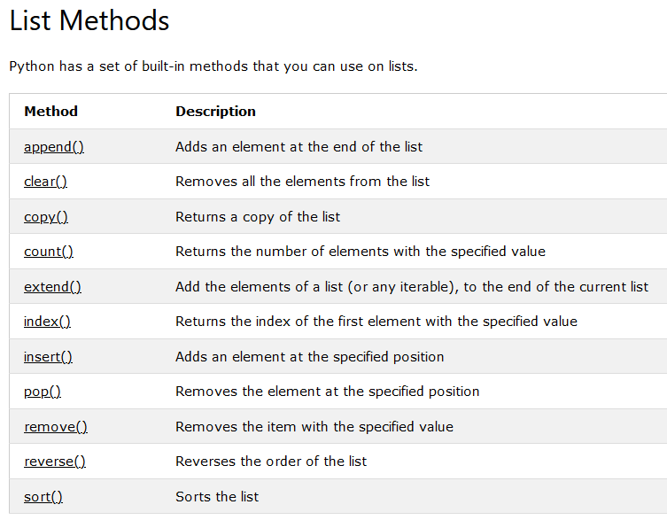
https://www.w3schools.com/python/python_ref_list.asp

Slide 7
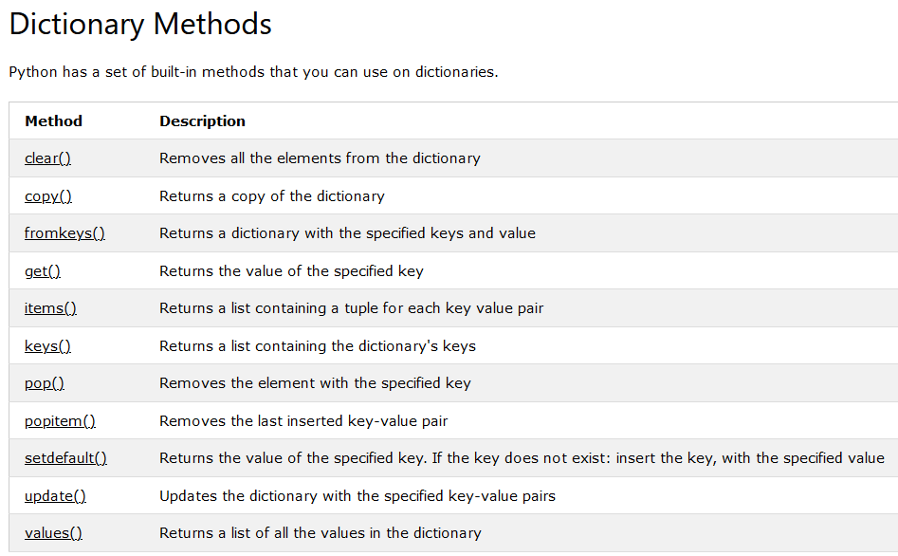
https://www.w3schools.com/python/python_dictionaries.asp

Slide 8
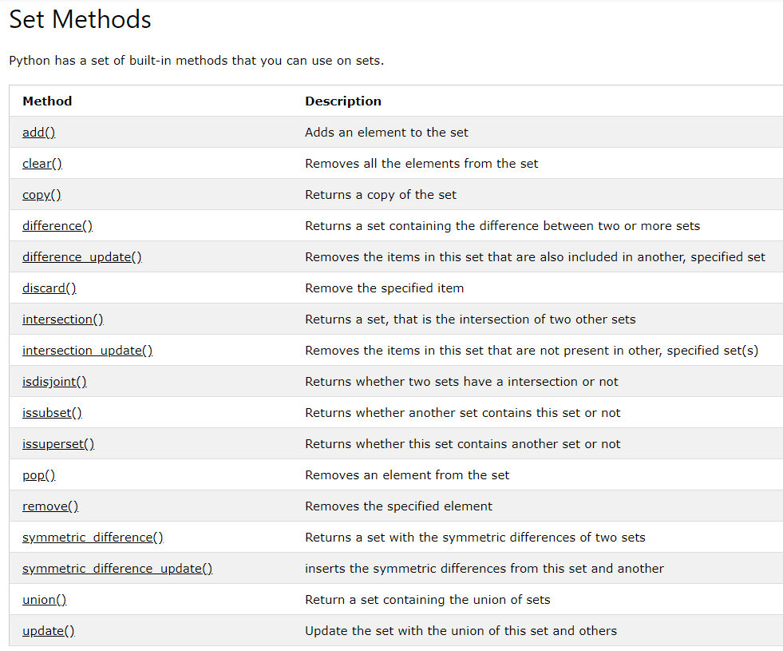
https://www.w3schools.com/python/python_sets.asp

Slide 9
Sequence
(working with tuples)

Slide 10
tuple operations
Get the first element of the tuple:
seq[0]
Get the rest of the elements, excluding the first:
seq[1:]
Get the last element of the tuple:
seq[-1]
Get the rest of the elements, excluding the last:
seq[:-1]
Time: O(1)
Space: O(1)
Time: O(n)
Space: O(n)
Time: O(1)
Space: O(1)
Time: O(n)
Space: O(n)
Tuple is immutable

Slide 11
Key recursive Idea(s):
Handle the First Element and then the Rest
…recurs up the sequence!
or
Handle the Last Element
and then the Rest
…recurs down the sequence!

Slide 12
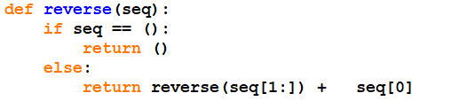
Eg 1: Reversing a Sequence (v1)
For a given tuple, we want the reverse of the tuple
e.g. for (1, 2, 3, 4), we want to output (4, 3, 2, 1)
( , )
Tuple to concatenate with tuple
Time is O(n²) … from sum of n-1, n-2, …, 1
Space is O(n²) … from sum of n-1, n-2, …, 1

Slide 13
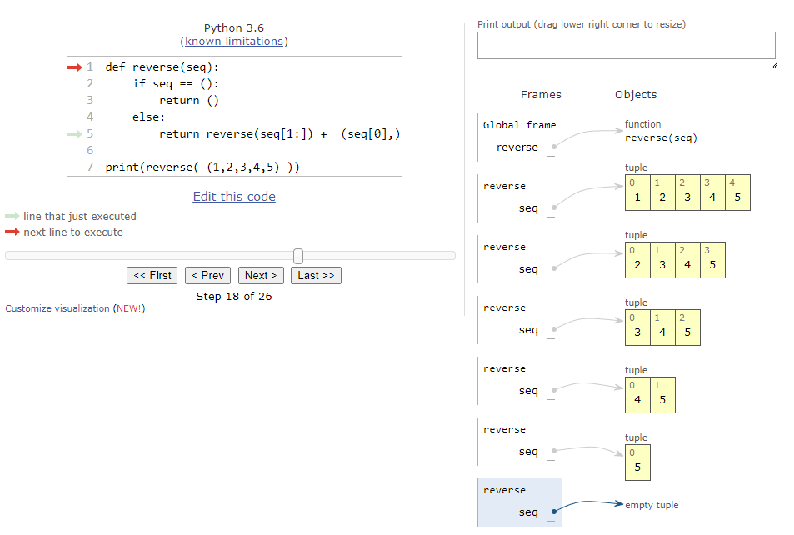
Eg 1: Reversing a Sequence (v1)

Slide 14
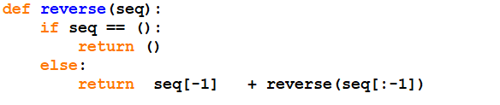
Eg 1: Reversing a Sequence (v2)
( , )
Tuple to concatenate with tuple
Time is O(n²) … from sum of n-1, n-2, …, 1
Space is O(n²) … from sum of n-1, n-2, …, 1

Slide 15
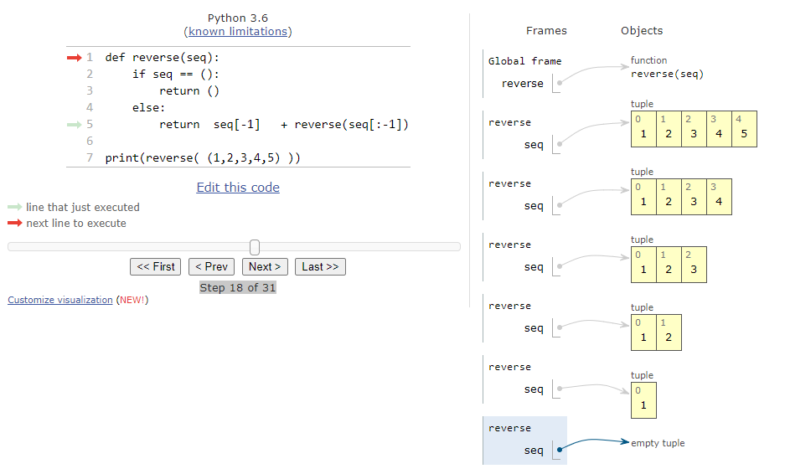
Eg 1: Reversing a Sequence (v2)

Slide 16
Key iterative Idea(s):
Handle the First Element and then the Rest
…move forward the sequence!
or
Handle the Last Element
and then the Rest
…move backward the sequence!

Slide 17
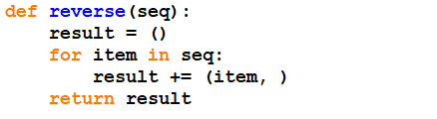
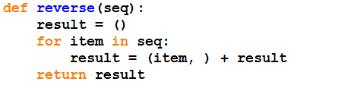
Eg 1: Reversing a Sequence (v3)
Tuple concatenation : be careful order
Time is O(n²) … sum of 1, 2, …, n
Space is O(n) … result can re-use the space

Slide 18
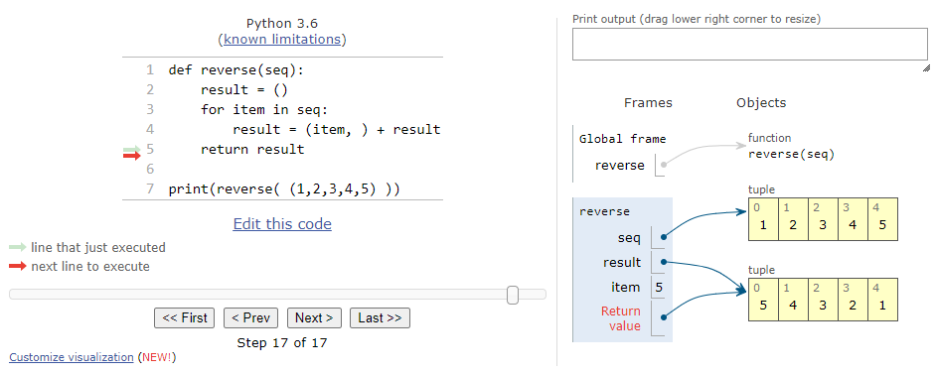
Eg 1: Reversing a Sequence (v3)

Slide 19
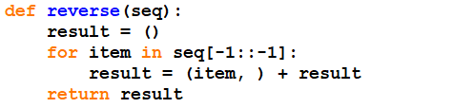
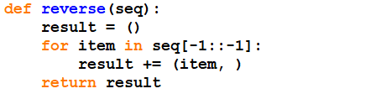
Eg 1: Reversing a Sequence (v4)
Tuple concatenation : be careful order
Time is O(n²) … sum of 1, 2, …, n
Space is O(n) … result can re-use the space

Slide 20
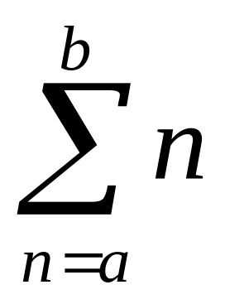
Abstracted as…
Lecture 6
def sum(term, a, next, b):
if a > b:
return 0
else:
return term(a) + sum(term, next(a), next, b)
def sum_integers(a, b):
return sum(lambda x: x,
a,
lambda x: x+1,
b)

Slide 21
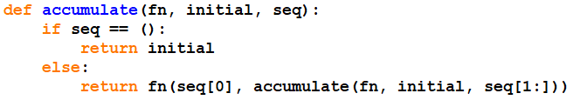
Abstracted as…accumulate
( , )
Time is ?
Space is ?
Iterative version – you can do it !

Slide 22
Abstracted as…accumulate
E.g.: to reverse a sequence
Time is ?
Space is ?
E.g.: to sum up a sequence
Time is ?
Space is ?

Slide 23
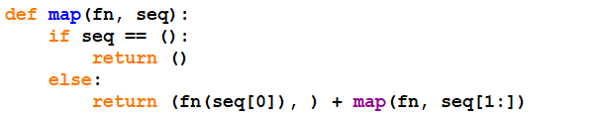
Abstracted as…map
Perform same operation (map) on every element
( a b c d )
( f(a) f(b) f(c) f(d) )
f
Same kind of recursive thinking…
Time O(n²)
Space O(n²)
Iterative version – you can do it !
Time O(n²), Space O(n)

Slide 24

Abstracted as…map
E.g.: to square each element of a sequence:
Time ?
Space ?
E.g.: To double each element of a sequence:
Time ?
Space ?

Slide 25
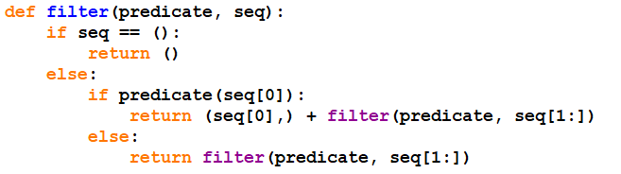
Abstracted as…filter
Same kind of recursive thinking…
Time O(n²)
Space O(n²)
Iterative version – you can do it !
Time O(n²), Space O(n)

Slide 26
Abstracted as…filter
E.g.: to keep only even numbers of a sequence:
Time ?
Space ?
E.g.: to keep only numbers divisible by d:
Time ?
Space ?

Slide 27


Abstracted as…enumerate
Reading from a file….Lecture 7
To generate a sequence….
E.g.: to generate 5 to 20
E.g.: to generate even numbers from 5 to 20
or
seq_even in previous slide

Slide 28
Computation as Signal Processing
(modularity)

Slide 29
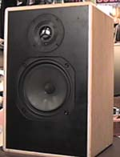
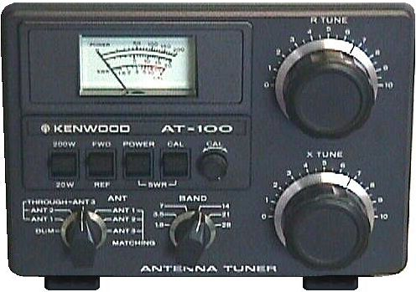
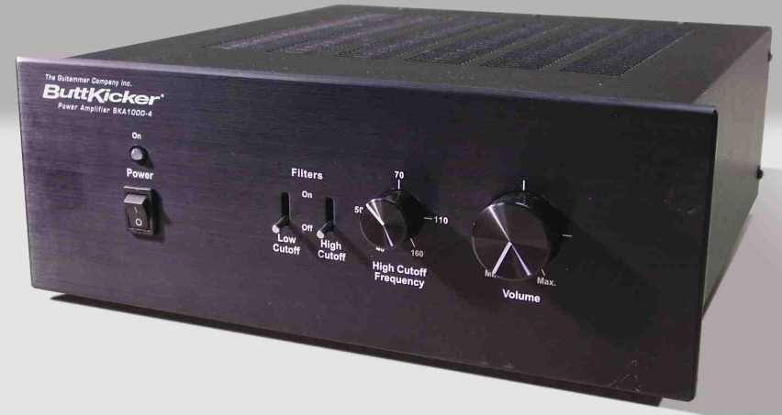
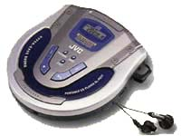

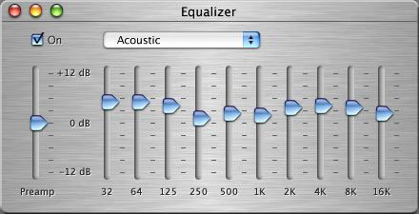
Listening to Music
Signal goes through various stages of processing
Additional component can be inserted
Easy to change component
Components interface via signals
Producer
Amplifier
Consumer
Filter
Converter

Slide 30
Modeling Computation as
Signal Processing
Signal is sequence
Producer (enumerator) creates signal
  enumerate_interval ( low, high )
Filter removes some elements
  filter( predicate, seq )
Mapper modifies signal
  map( fn, seq )
Consumer (accumulator) consumes signal
  accumulate( fn, seq )
Add Sorting and Searching (Lecture 9) – pretty much all

Slide 31
Benefits
Modularity: each component independent of others;
components may be re-used.
Clarity: separates data from processes
Flexibility: new component can be added

Slide 32
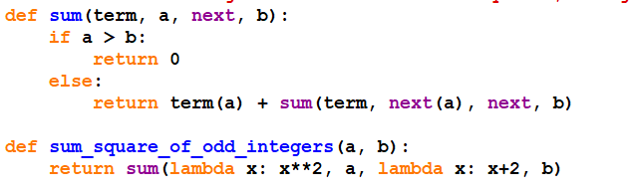
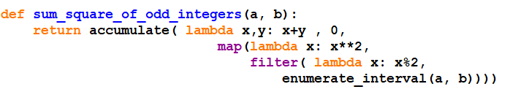
Eg 2: sum_square_of_odd_integers
From Lecture 6 solution
From signal processing view:
Enumerate:
a to b
Filter:
is_odd
Map:
square
Accumulate: add, 0

Slide 33
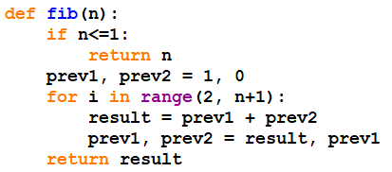
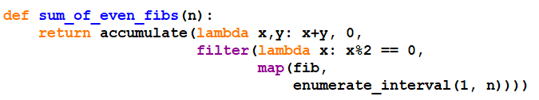
Eg 3: sum_of_even_fibs (n)
From signal processing view:
Enumerate:
1 to n
Map:
fib
Filter:
is_even
Accumulate:
lambda x,y: x+y

Slide 34
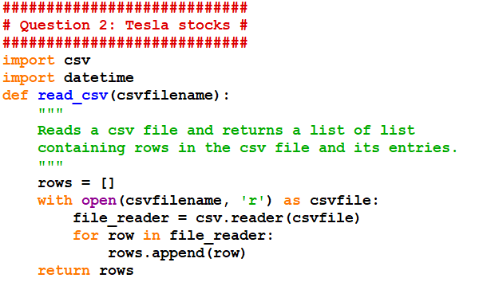
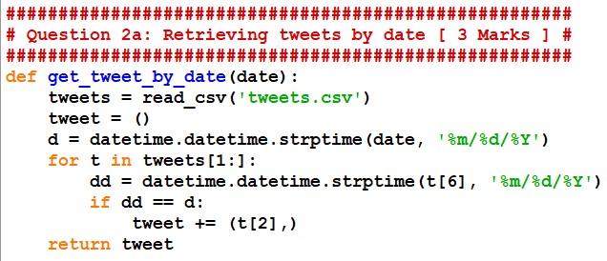
Example #2 (csv file)
Lecture 7
CS1010X PE
June 2020, Q2
“csv” stands for
“comma-separated values”
>>> get_tweet_by_date('12/21/2019')
>>> get_tweet_by_date('5/1/2020')

Slide 35
Recurring Theme
Many functions/features are provided already
E.g. Python has map, filter and accumulate
But, we (in higher education) need to know how it works
Why: it is not common in other languages that we may need to build it ourselves
Usually, we build a simple version to illustrate the point
E.g. Python’s map, filter, and accumulate are more powerful
This is not a course about Python per se
E.g. You don’t need to know Python reference manual well
Let’s see Python’s version in the next few slides

Slide 36
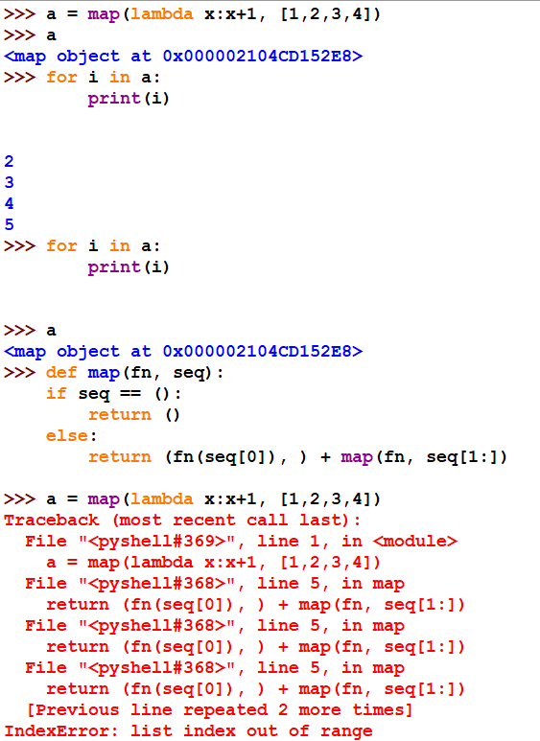
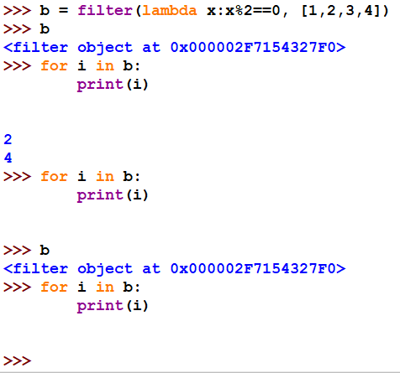
Python map, filter, accumulate
They output iterators (rather than explicit tuples)
Work for sequence in general, not just tuple
Our own map & filter
work only for tuples

Slide 37
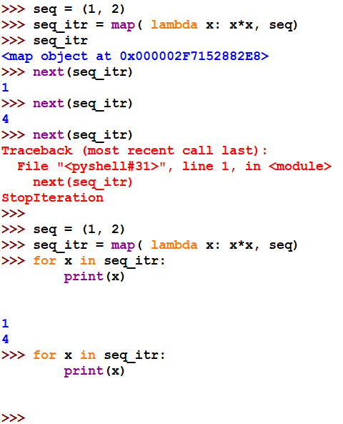
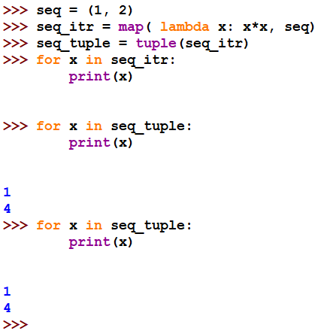
Python Iterators
An iterator is an object that contains a countable number of values
It can be iterated upon with iter() and next()
  Once use, it is gone. But, you can force it to be tuple, list, etc.
https://www.w3schools.com/python/python_iterators.asp

Slide 38
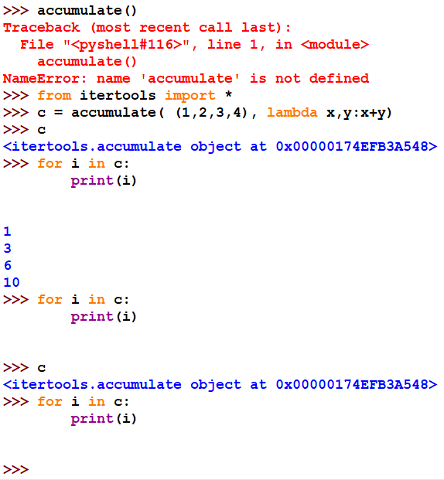
Python map, filter, accumulate

Slide 39
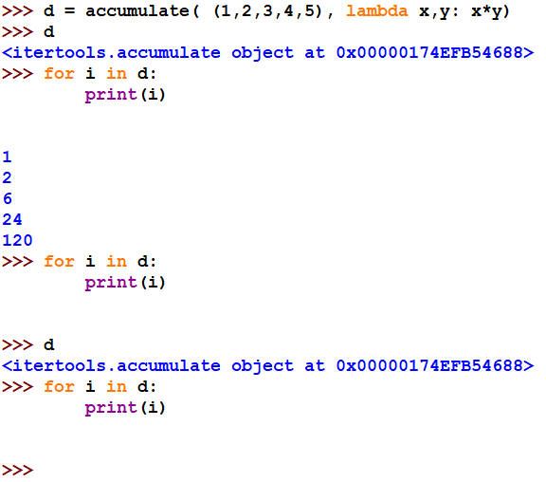
Python map, filter, accumulate
Given a sequence (x₁, x₂, x₃, …),
output a sequence (y₁, y₂, y₃, …) s.t. y_{i} = x₁ * x₂ *…*x_{i}
Our accumulate outputs
only 1 final number.
In saying so, our version is
actually the Python
“reduce”.

Slide 40
Tree
(tuple of tuples or sequence of sequences)

Slide 41
Tree
Tree is a sequence of sequences
  Closure property: a sequence included in another sequence is still a sequence
  This allows us to build hierarchical structures of tree
  ((1, 2), (3, 4), 5)
root
There are 5 leaves in this tree.
5
1
2
3
4
leaves

Slide 42
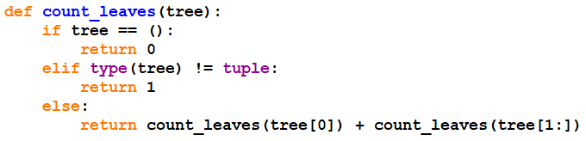
Eg 4: count_leaves
For a given tree (sequence of sequences),
output the number of leaves in the tree
5
1
2
3
4
work to be done (in stack):
1
2
3
4
5
partial answer:

Slide 43
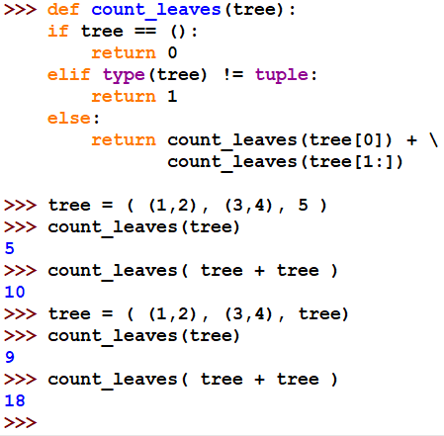
Eg 4: count_leaves
5
1
2
3
4
5
1
2
3
4
( (1,2), (3,4), 5, (1,2), (3,4), 5)
( (1,2), (3,4), ((1,2), (3,4), 5) )
( (1,2), (3,4), ((1,2), (3,4), 5), (1,2), (3,4), ((1,2), (3,4), 5) )

Slide 44
Eg 5: tree_flatten (idea)
For a given tree (sequence of sequences),
Output a sequence of leaves
( )
5
(tree,)
1
2
3
4
work to be done (in stack):
partial answer:
1
2
3
4
5
(1,)
(1, 2)
(1, 2, 3)
(1, 2, 3, 4)
(1, 2, 3, 4, 5)

Slide 45
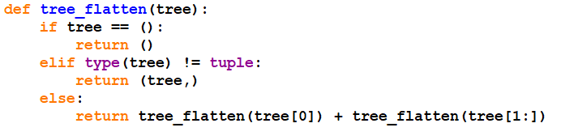
Eg 5: tree_flatten (code)
For a given tree (sequence of sequences),
Output a sequence of leaves
5
1
2
3
4
work to be done (in stack):
partial answer:
1
2
3
4
5
(1,)
(1, 2)
(1, 2, 3)
(1, 2, 3, 4)
(1, 2, 3, 4, 5)

Slide 46
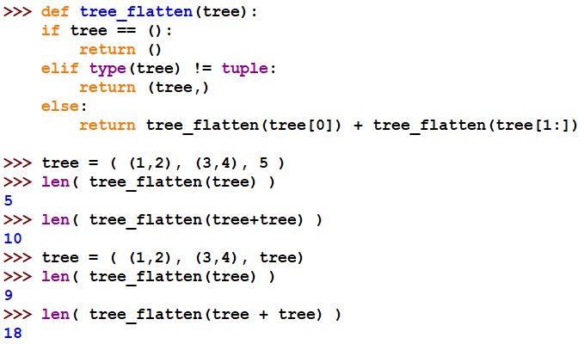
Recap Eg 4: count_leaves
Use of tree_flatten…
(1,2,3,4,5)
(1,2,3,4,5,1,2,3,4,5)
(1,2,3,4,1,2,3,4,5)
(1,2,3,4,1,2,3,4,5,1,2,3,4,1,2,3,4,5 )

Slide 47
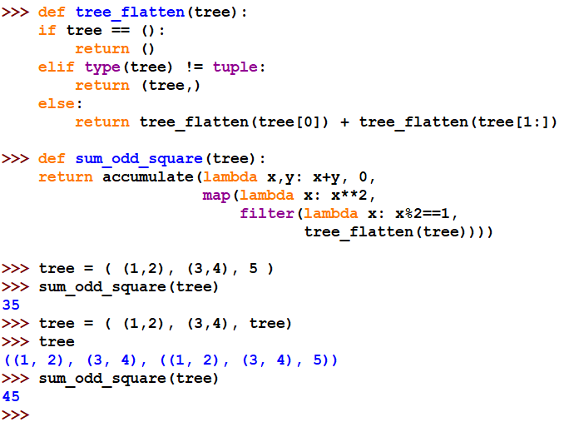
Eg 6: sum_odd_square(tree)
Want to sum the squares of those leaves with odd numbers:
(use our own
accumulate,
map, filter)
signal processing view
5
1
2
3
4

Slide 48
Eg 7: tree_scale (tree, factor)
Want to scale each leaf by a factor:
E.g.
tree_scale (tree, 2)
5
10
1
2
3
4
2
4
6
8
( (1,2), (3,4), 5 )
( (2,4), (6,8), 10 )

Slide 49
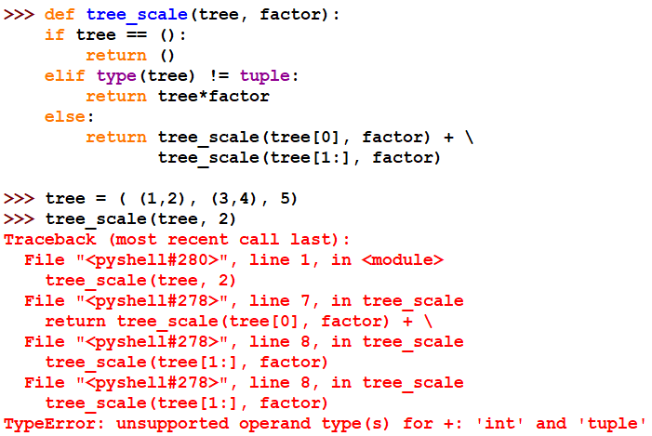
Eg 7: tree_scale (tree, factor) Attempt #1
Want to scale each leaf by a factor:
tuple
int

Slide 50
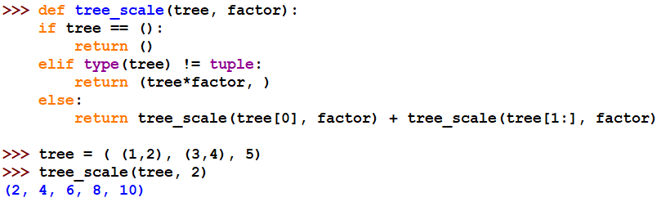
Eg 7: tree_scale (tree, factor) Attempt #2
Exactly the same structure here
as in the case of tree_flatten
5
2
4
6
8
10
1
2
3
4

Slide 51
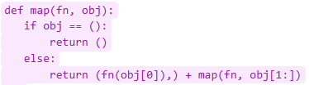
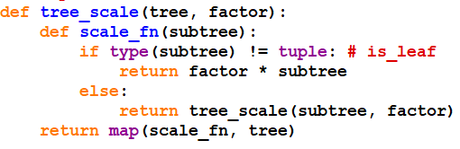
Eg 7: tree_scale (tree, factor) Attempt #3
5
1
2
3
4
work to be done (in stack):
2
2
1
1
1
1
1
2
1
1
1
1
2
2
1
2
1
1
partial ans:
((2, 4), (6,8), 10)
( (), )
((2,4),)
((2, 4), (6,))
()
((2,),)
((2, 4), ())
((2, 4), (6,8))

Slide 52
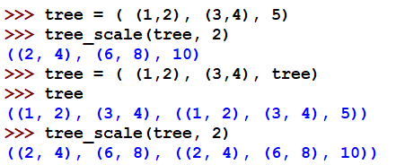

Eg 7: tree_scale (tree, factor) Attempt #3
(ok)
5
1
2
3
4
5
1
2
3
4

Slide 53
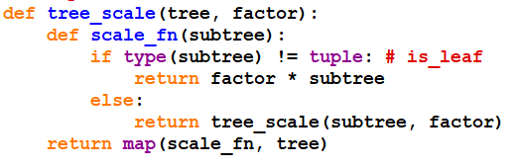

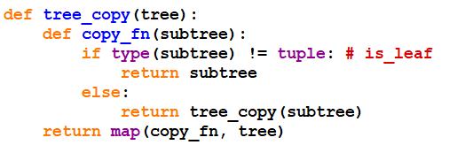
Eg 8: tree_copy(tree)
Input a tree, output a copy of the tree

Slide 54

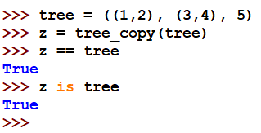
Eg 8: tree_copy(tree)
Input a tree, output a copy of the tree
Does this work?

Slide 55
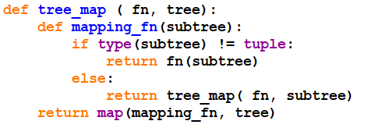

Eg 9: tree_map vs map

Slide 56
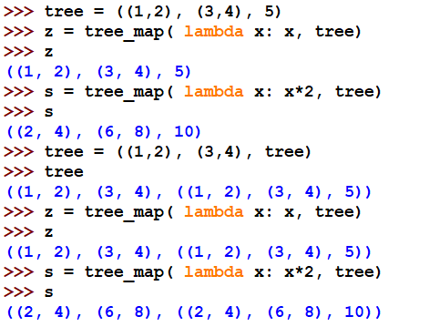
Eg 9: tree_map vs map
tree_copy
tree_scale
tree_copy
tree_scale

Slide 57
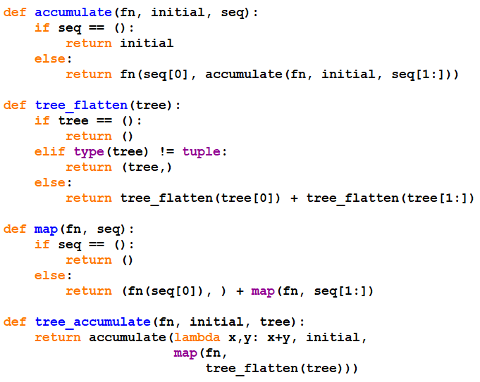
Eg 10: tree_accumulate vs accumulate
want to apply a function to each leaf, and then accumulate/sum up
# signal processing view

Slide 58
Eg 11: tree_filter vs filter
???

Slide 59


Recap recursion vs iteration?
Recursion is common for tree
Iteration is hard for tree – need own stack
Recap Eg 4: count_leaves
recursive

Slide 60


Recap recursion vs iteration?
Recursion is common for tree
Iteration is hard for tree – need own stack
Recap Eg 4: count_leaves

Slide 61

Recap Eg 5: tree_flatten
Recap recursion vs iteration?

Slide 62

Recap recursion vs iteration?
Recap Eg 5: tree_flatten

Slide 63
Recap Eg 7: tree_scale
Recap Eg 8: tree_copy
Recap recursion vs iteration?
Not easy….
Need to keep track of matching parenthesis
Need to mark beginning and ending matches
…

Slide 64
Summary
Nothing new….working with tuple…reappearing
L6 higher order function to work with sequence
Signal processing view to manage complexity
  data often comes as a sequence
  enumeration, map, filter, accumulate, sort, search
  Allow re-use, clear, flexible
Tree as sequences of sequence
  Recursion vs iteration

